Slide 1
Human Occupied Modular Environment
H.O.M.E.
Jason Siwek
Lauren Norman
Henry Trimbach
Heather Moulton
Notes:
Good morning/afternoon. We represent the Human Occupied Modular Environment, or HOME, group from Roger Williams University, and will be presenting on our paper submission, “Electrical Research of the HOME”. I’m Henry Trimbach, and these are my teammates, Lauren Norman, Jason Siwek, and Heather Moulton.

Slide 2
Internally Displaced Persons
Remain within country’s borders
In 2009: estimated 27 million IDP
70% were women and children.

Slide 3
Problem Statement
“[Create a structure that] will provide basic human amenities including food growth, water collection and filtration, storage, electricity, ventilation, temperature control, and waste management, without the benefit of any local utility infrastructure.”

Slide 4
Design Requirements
Uses no moving parts, fasteners, or instructions
Incorporates all basic living necessities; shelter, power, water, ventilation, personal storage
Off-grid power, entirely renewable and sustainable sources used
Accounts for UN Shelter Centre guidelines concerning sustainability, cultural, usability, environmental safety and health factors

Slide 5
Power Cap
Ventilation Holes
6 feet
Stringers

Slide 6
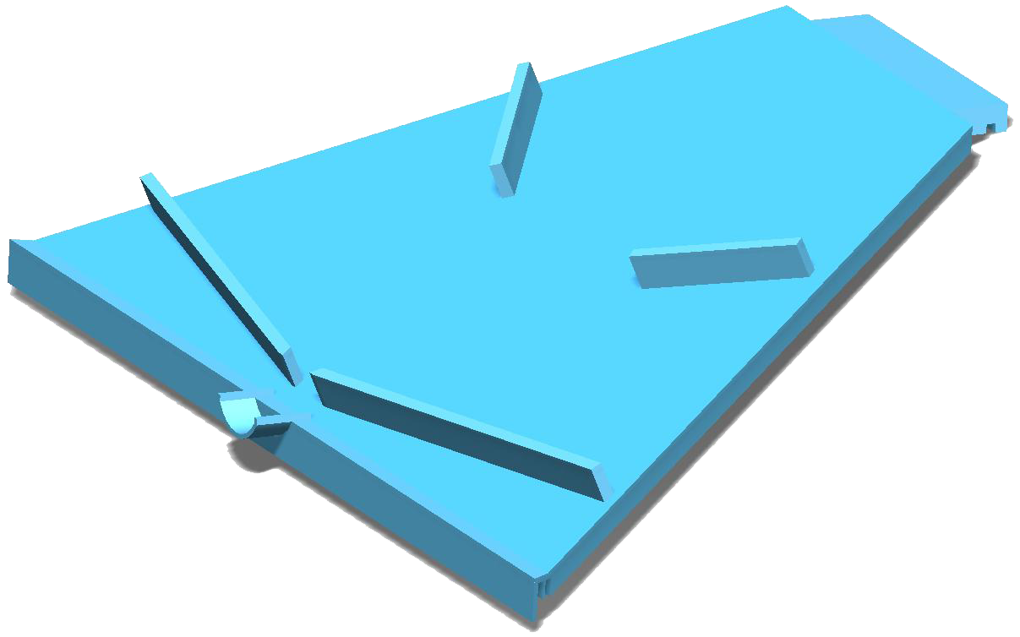
Water Systems
Three Functions:
Collection of rainwater
Glides integrated
into roof panel
design

Slide 7
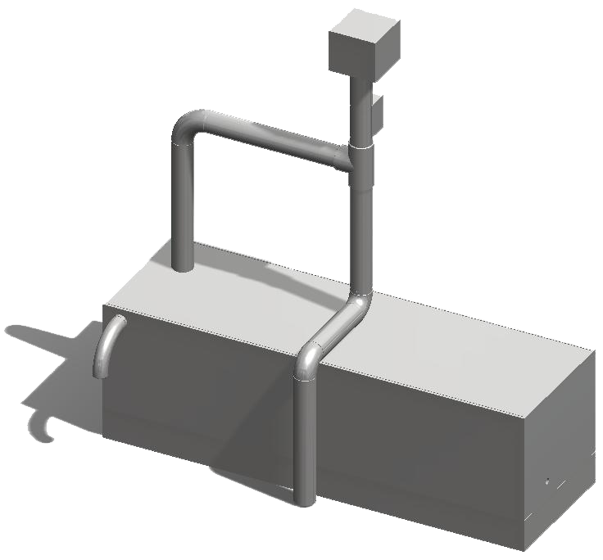
Water Systems
Three Functions:
Filtration
Primary Filtration
First flush diverter

Slide 8
Water Systems
Three Functions:
Storage
Particulate Settling

Slide 9
Power Use
Outlet
Charging of small electronic devices
Assumed use of 100 Watt-hours/day
Power Consumption of Typical Appliances:
Laptop PC | 40 Watt-hours
Charging a Cell Phone | 15 Watt-hours
Small Fan | 20 – 40 Watt-hours
Lamps/Flashlights | 10 – 20 Watt-hours

Slide 10
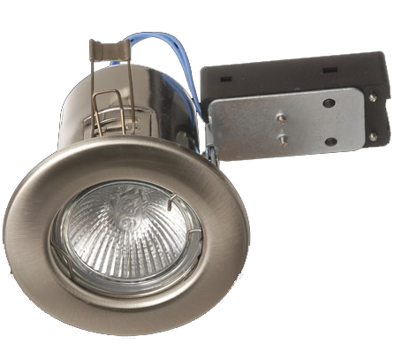
Power Use
Recessed Interior Lighting
Six 5-Watt LED bulbs
Assumed use of 12 hrs/day
6 lights x 5 Watts/light = 30 Watts of lighting
30 Watts x 12 hours/day = 360 Watt-hours/day
Total of 360 Watt-hours/day

Slide 11
Sources Considered
Fuel Cell
Concerns for safety
Need continual fuel supply
Wind
Complex assembly
Scale

Slide 12
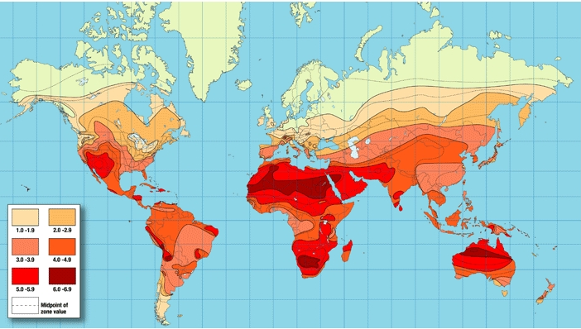
Sources Considered
Solar
Ideal for geographical
target market
Simple
Human
Occupants control available power
Average power production of 75 – 100 Watts per hour

Slide 13
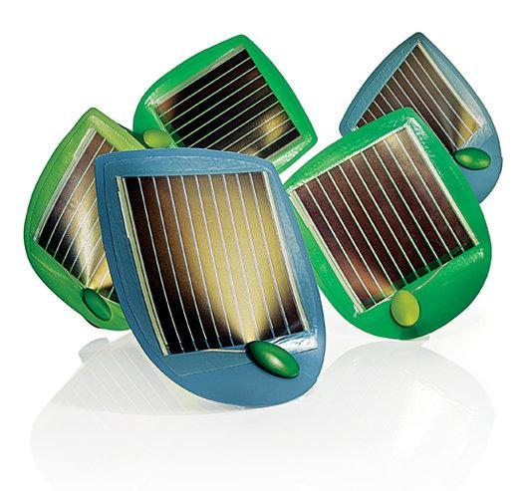
Design Selection – Solar Power
Research conducted into innovative photovoltaics
Ivy-mimicking arrays
Tracking panels
Solar Shingles
Not yet practical or cost-effective

Slide 14
Design Selection – Solar Power
Traditional arrays:
Polycrystalline panels selected as source
Cell Type | Efficiency | Notes
Polycrystalline | 13-15% | Between
Monocrystalline | 14-17% | Extremely Fragile
Amorphic | 5-7% | Flexible

Slide 15
Design Selection – Solar Power
Desired dimensions:
Hexagonal cap with 64” diameter (32” sides)
To maximize power output via area, panels should be between 9 – 12 inches in length and 8 – 10 inches in width.

Slide 16
Design Selection – Solar Power
Using eighteen of the selected panels will:
Cost $630
Weigh 29.7 lbs
Provide 90 Watts of power

Slide 17
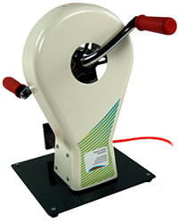
Design Selection – Human Power
Windstream Human Power Generator®
Crank attached to a drive chain
Cost $550

Slide 18
Integrated Design
Electrical System
Structure
Water System

Slide 19
Thank you!

Slide 20
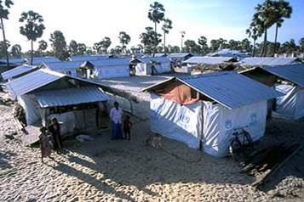
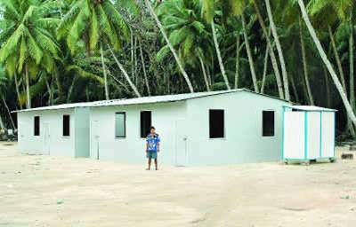
Existing Shelter
Emergency Shelter
Transitional Shelter
Permanent Shelter

Slide 21
Design Requirements

Slide 22
Structural Specifications
Hexagonal Structure
138 sq. feet of floor space
26 degree roof pitch
Wall Panels
7’ wide x 6’ high
Held together by stringers
Central Support Column
8” Diameter Schedule 80 PVC Pipe

Slide 23
Electrical Components
Component | Cost/Unit
SolarLand 5 W Panel | $35.00
Human Power Generator | $550.00
Voltage Regulator | $1.59
12 V Deep Cycle Battery | $80 - $120
TwiceBright Lighting Units | $30
5 W LED Bulbs | $12
Inverter/Outlet | $100 - $150
Wiring | ~ $20
Total Electrical Component Cost of $1630 - $1730

Slide 24
Water Components
Component | Cost/Unit
First Flush Diverter | $23.95
PVC Piping (Schedule 40) | $27
Elbows/Fittings | $22.24
Tank | $100
Meshes | ~$5
Inflow Assembly | $80
Guttersnipe Shield | ~$15
Total Water Component/Material Cost of ~$275

Slide 25
Water Filtration - Primary
Initial 5 mm self-cleaning mesh
Secondary 1 mm self-cleaning mesh

Slide 26
Material Cost
Component | Cost
Electrical System | $1680
Water System | $275
8” Diameter PVC Column (Schedule 80) | $100
HDPE Plastic Sheeting (Structure) | $4000
TOTAL | $6,055

Slide 27
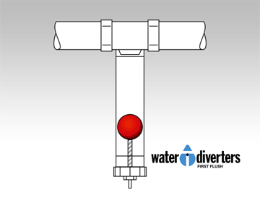
Water Filtration – First Flush Diverter

Slide 28
Scaled Roof Panel Testing
Built several scaled models using clay and PVC sheeting
Two glide designs
Sculpted design
Colored water used for visual tests

Slide 29
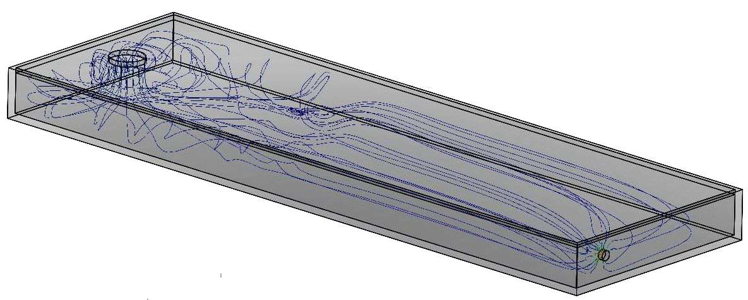
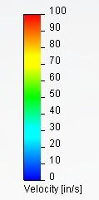
Tank Analysis for Particulate Resuspension

Slide 30
Human Power Testing
Four participants
Measured current, voltage, and power continuously
30-second & 2-minute trials
Crank vs. Bike power
Seated vs. Standing positions

Slide 31
Human Power Testing
Participant | Bicycle | Seated | One-Hand | Two-Hand
1 | - | 15.075 | 16.083 | 14.348
2 | - | 7.848 | 7.2869 | 16.173
3 | 20.191 | 14.408 | 13.567 | 15.567
4 | 25.302 | 18.508 | 10.640 | 22.802
Totals | 22.746 | 13.96 | 11.894 | 17.223

